Slide 1
Motion graphs
Pg 18.

Slide 2
Motion graphs

Slide 3
Motion graphs
Using the graph, find speed, find velocity

Slide 4
Motion graphs
Finding instantaneous speed

Slide 5
Motion graphs
Finding instantaneous speed
Instantaneous speed = $\frac{350−230}{2600−1800}$ = $\frac{120}{600}$ = 0.2 m/s

Slide 6
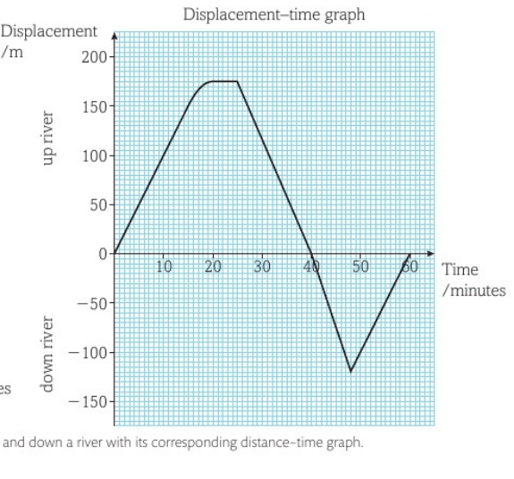
Motion graphs
Find the acceleration in during:
0-15 minutes
15-20 minutes during the run

Slide 7
Motion graphs

Slide 8
Motion graphs
Find the speed in using the velocity-time (v-t) graph

Slide 9
Motion graphs
https://youtu.be/E43-CfukEgs?si=P_it9OiBn74XZtB8

